Slide 1


Malignant-Comments-Classifier
Submitted By:- Ojasav Sahu
Internship :- 23

Slide 2
Table of Contents:-
Acknowledgment
Problem Statement
Data Source and their description
Data Analysis
Visualization
Model Building
Key Findings and Conclusion of the Study

Slide 3
Acknowledgment
First, I would like to express my gratitude towards Flip Robo Technologies for their kind co- operation and encouragement which help me in completion of this project.
I would like to express my special gratitude and thanks to industry persons and my mentor Miss. Sapna Verma for giving me such attention and time as and whenever required.
Research papers that helped me in this project was as follows:
https://medium.com/@dobko_m/nlp-text-data-cleaning-and-preprocessing-ea3ffe0406c1
https://towardsdatascience.com/your-guide-to-natural-language-processing-nlp-48ea2511f6e1
Articles that helped me in this project was as follows:
TF-IDF Vectorizer scikit-learn. Deep understanding TfidfVectorizer by… | by Mukesh Chaudhary | Medium

Slide 4
Problem Statement
The proliferation of social media enables people to express their opinions widely online. However, at the same time, this has resulted in the emergence of conflict and hate, making online environments uninviting for users.
Although researchers have found that hate is a problem across multiple platforms, there is a lack of models for online hate detection. Online hate, described as abusive language, aggression, cyberbullying, hatefulness and many others has been identified as a major threat on online social media platforms. Social media platforms are the most prominent grounds for such toxic behaviour.
There has been a remarkable increase in the cases of cyberbullying and trolls on various social media platforms. Many celebrities and influences are facing backlashes from people and have to come across hateful and offensive comments. This can take a toll on anyone and affect them mentally leading to depression, mental illness, self-hatred and suicidal thoughts.
Internet comments are bastions of hatred and vitriol. While online anonymity has provided a new outlet for aggression and hate speech, machine learning can be used to fight it.
The problem we sought to solve was the tagging of internet comments that are aggressive towards other users. This means that insults to third parties such as celebrities will be tagged as unoffensive, but “u are an idiot” is clearly offensive.
Our goal is to build a prototype of online hate and abuse comment classifier which can used to classify hate and offensive comments so that it can be controlled and restricted from spreading hatred and cyberbullying.

Slide 5
Data Source and their Description
The data was provided by FlipRobo in CSV format. After loading the training dataset into Jupyter Notebook using Pandas and it can be seen that there are eight columns named as:
“ id, comment_text, “malignant, highly_malignant, rude, threat, abuse, loathe”.
There are 8 columns in the dataset provided:
The description of each of the column is given below:
Malignant: It is the Label column, which includes values 0 and 1, denoting if the comment is malignant or not.
Highly Malignant: It denotes comments that are highly malignant and hurtful.
Rude: It denotes comments that are very rude and offensive.
Threat: It contains indication of the comments that are giving any threat to someone.
Abuse: It is for comments that are abusive in nature.
Loathe: It describes the comments which are hateful and loathing in nature.
ID: It includes unique Ids associated with each comment text given.
Comment text: This column contains the comments extracted from various social media platforms.

Slide 6
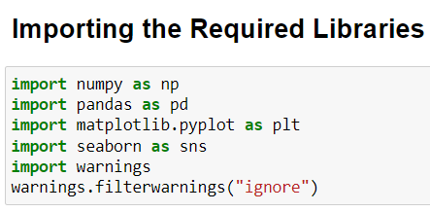
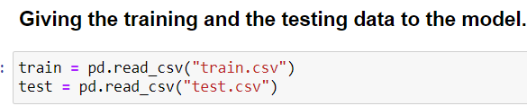
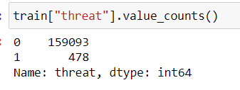
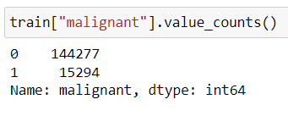
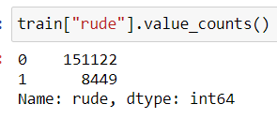
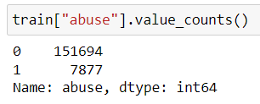
Data Analysis

Slide 7
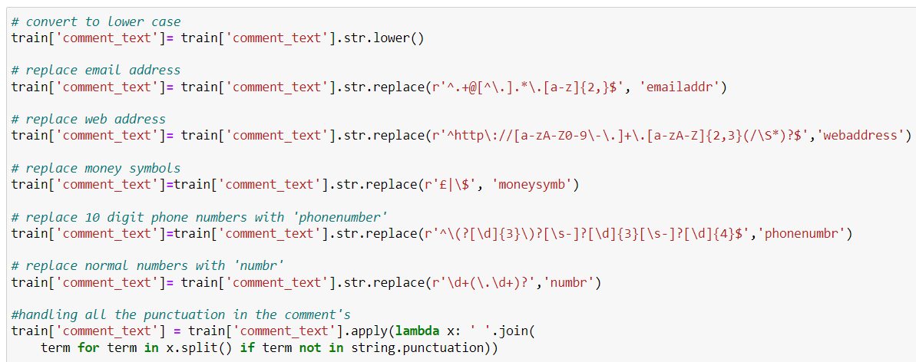
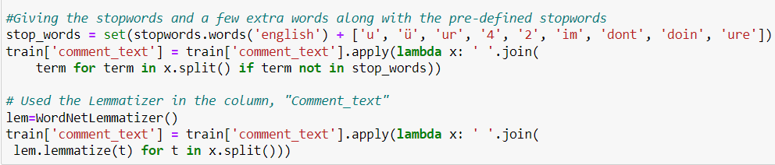

Slide 8
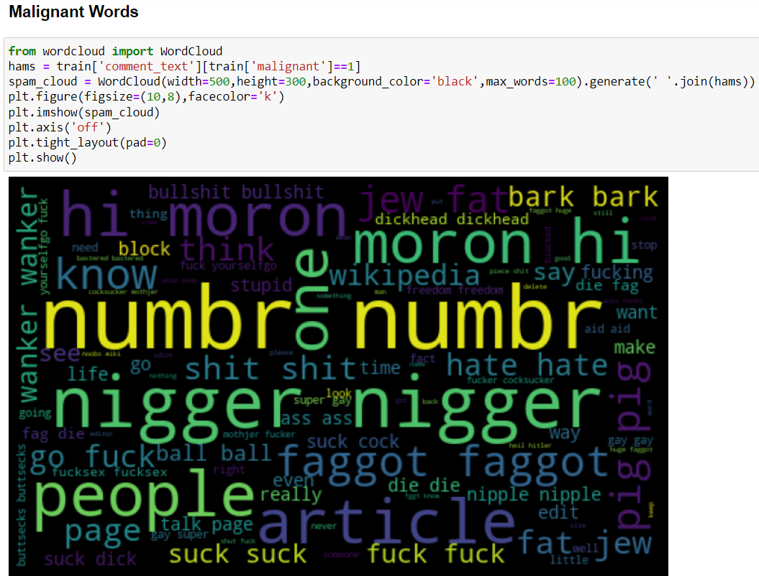
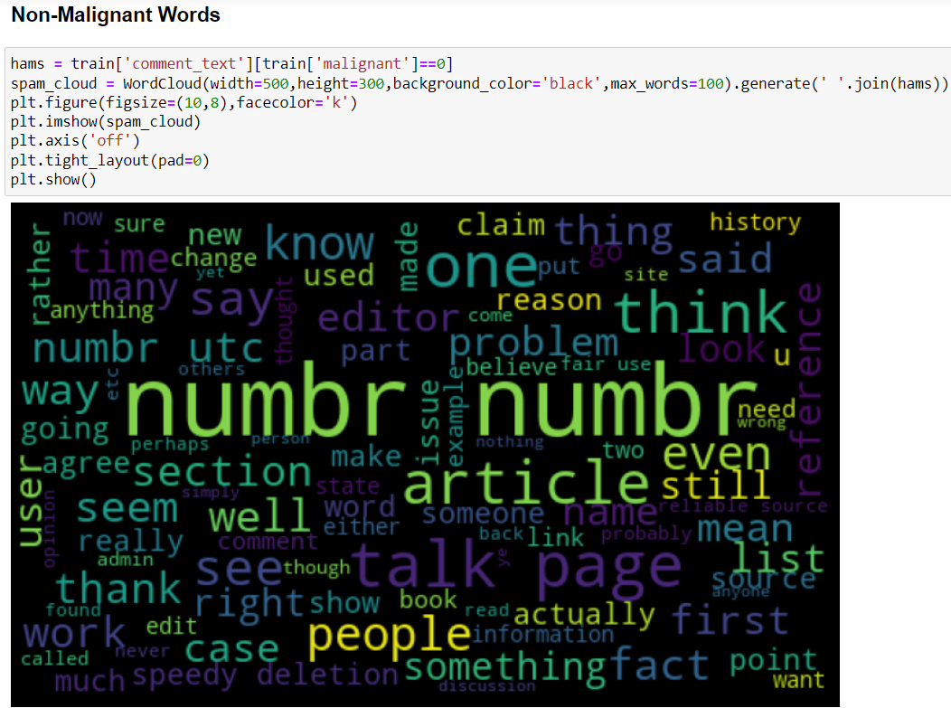
Visualization

Slide 9
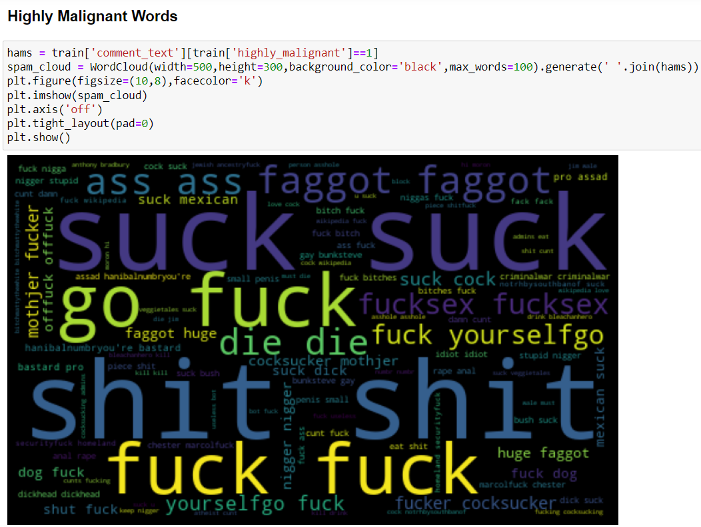
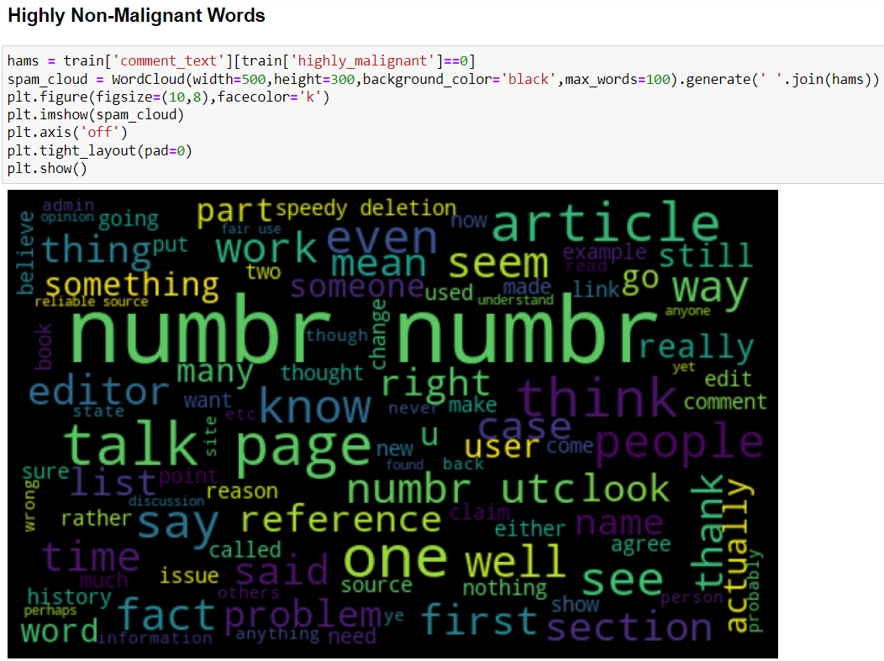

Slide 10
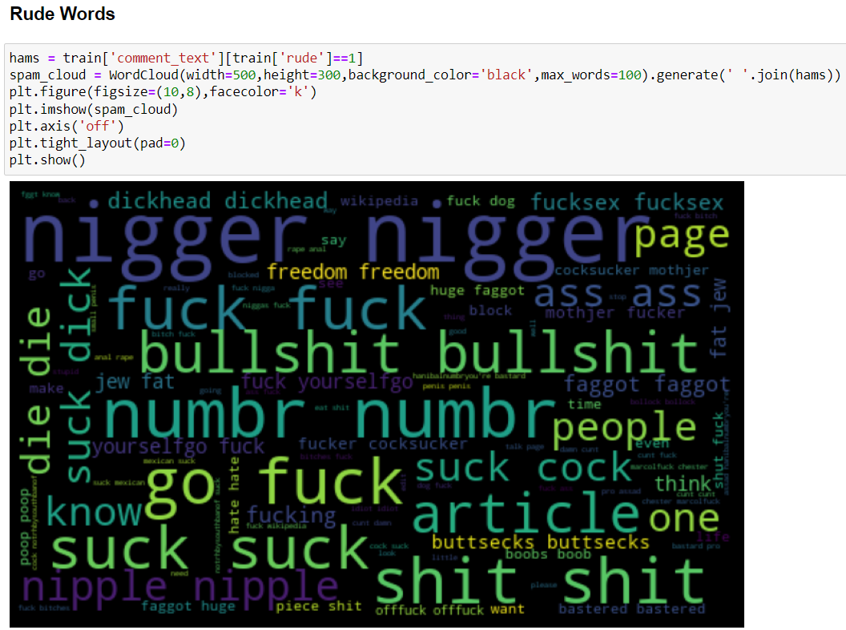
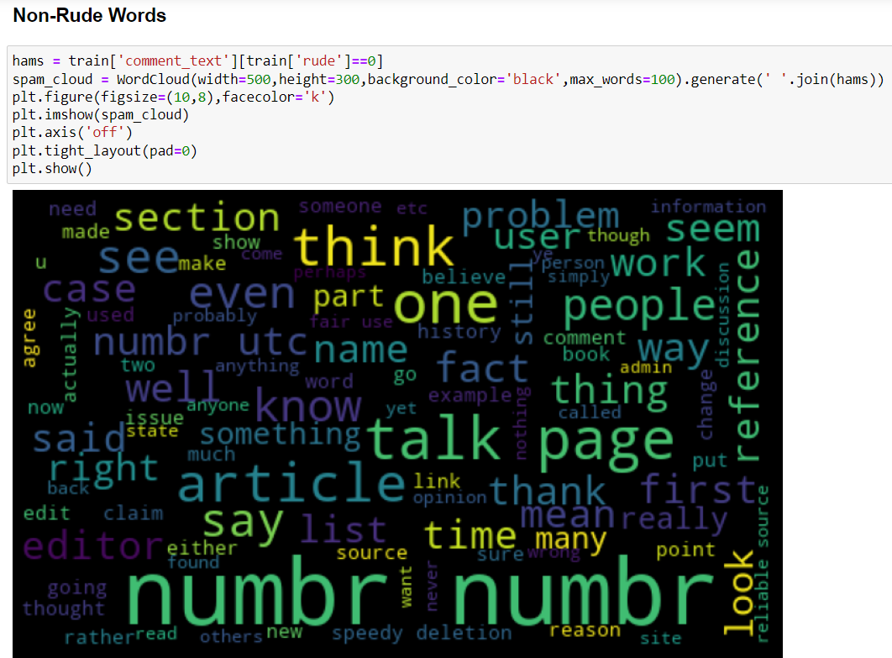

Slide 11
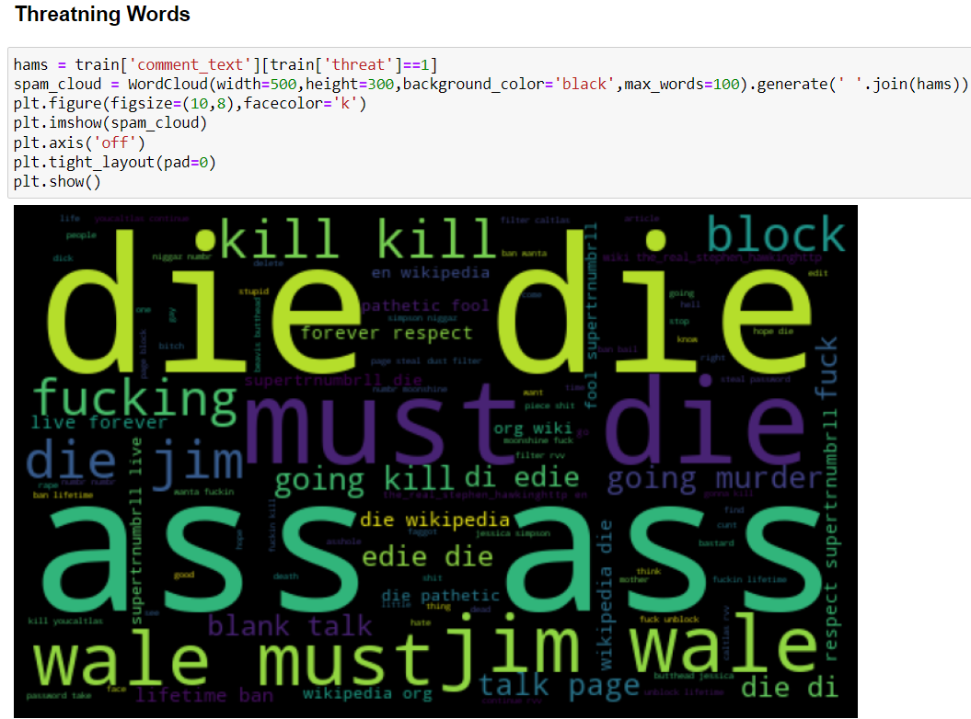
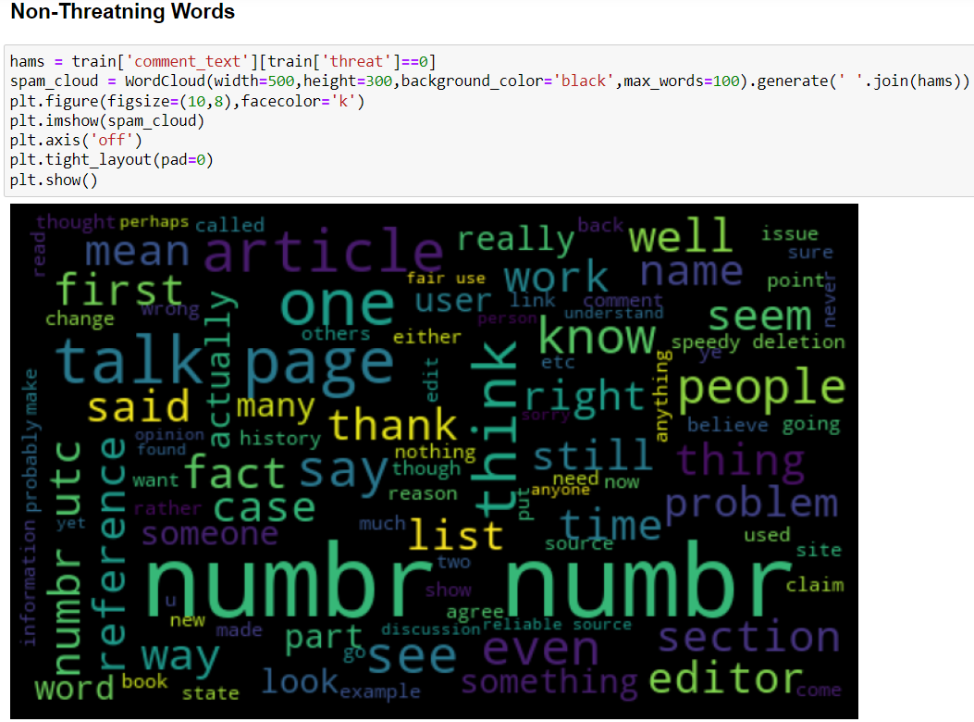

Slide 12
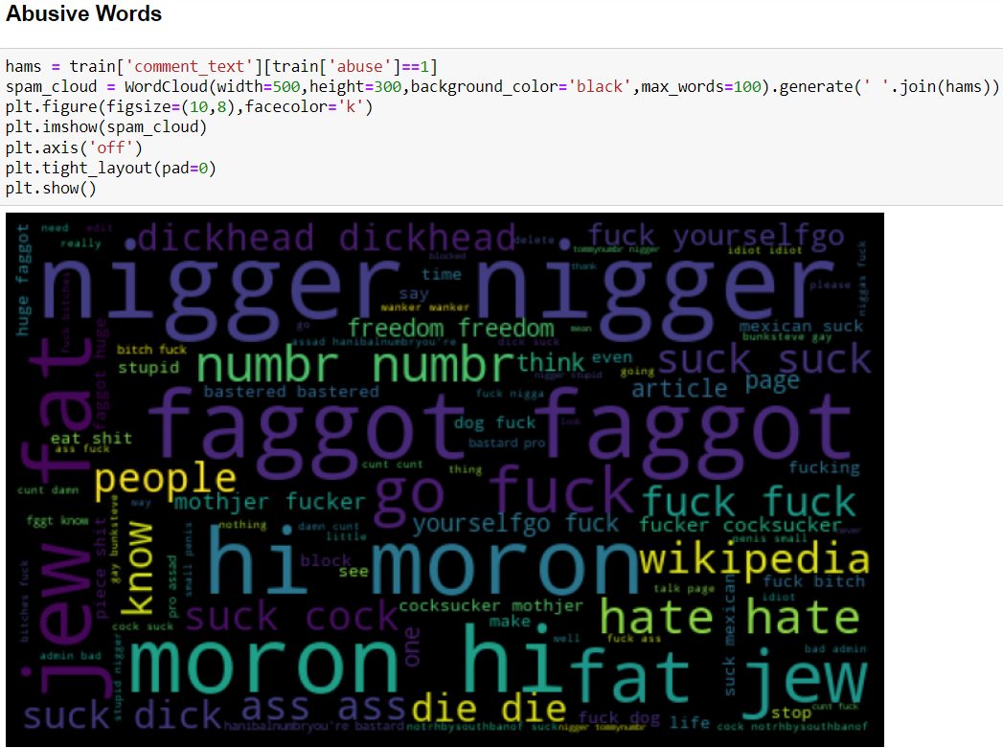
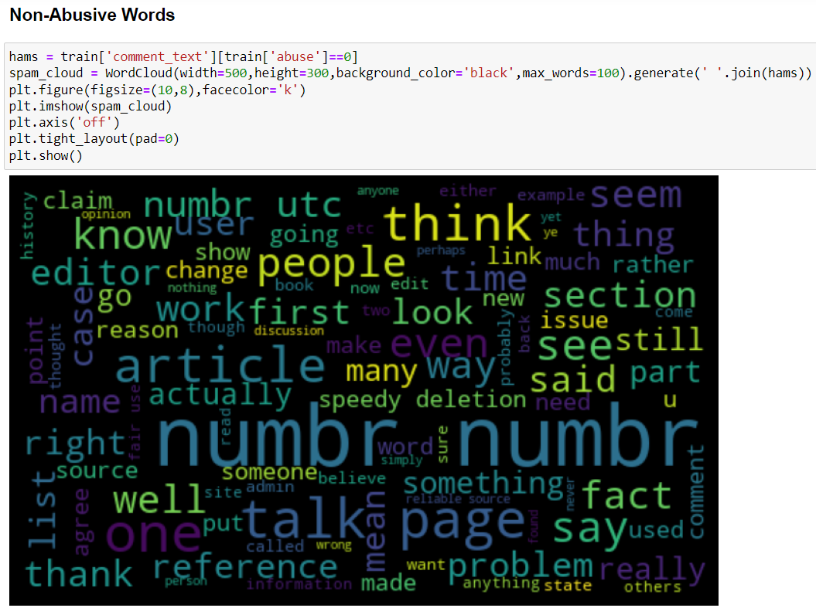

Slide 13
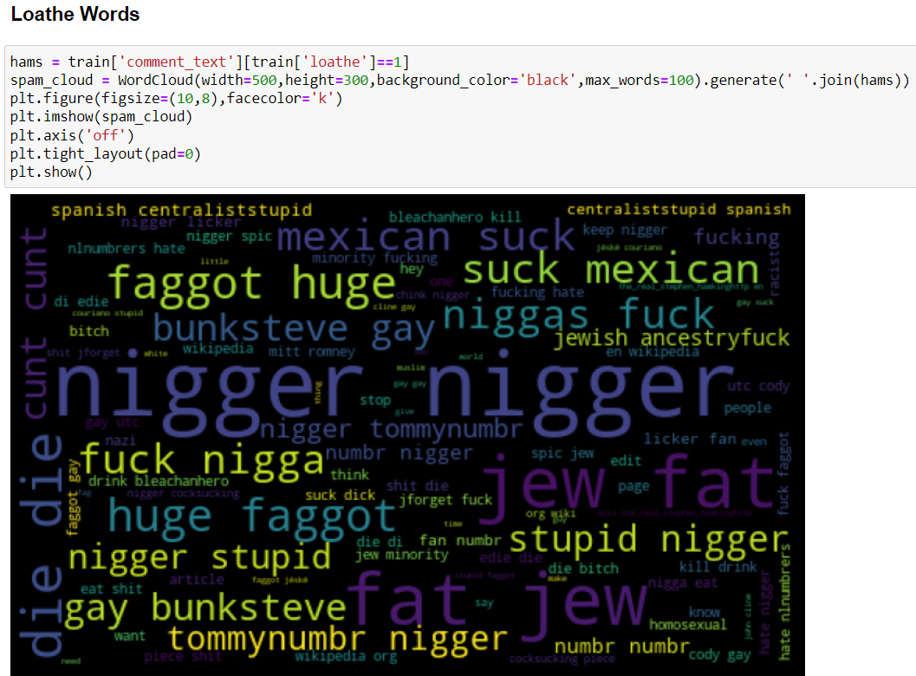
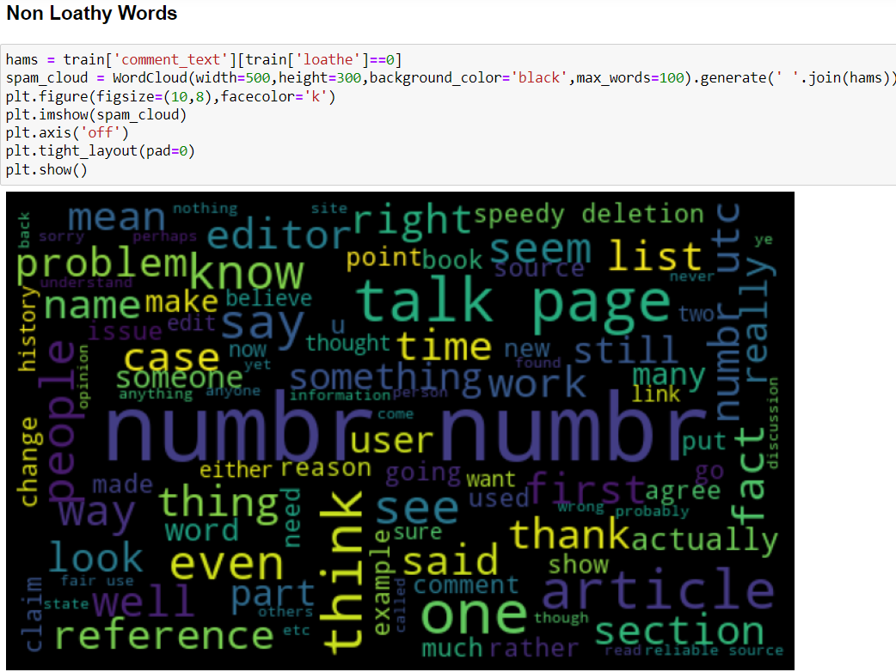

Slide 14
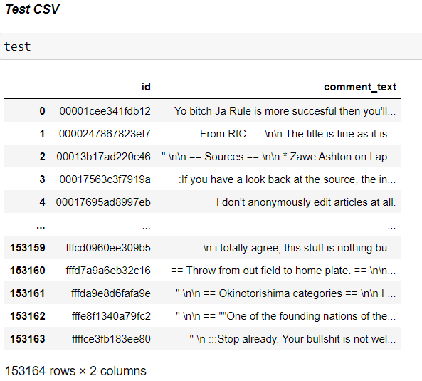
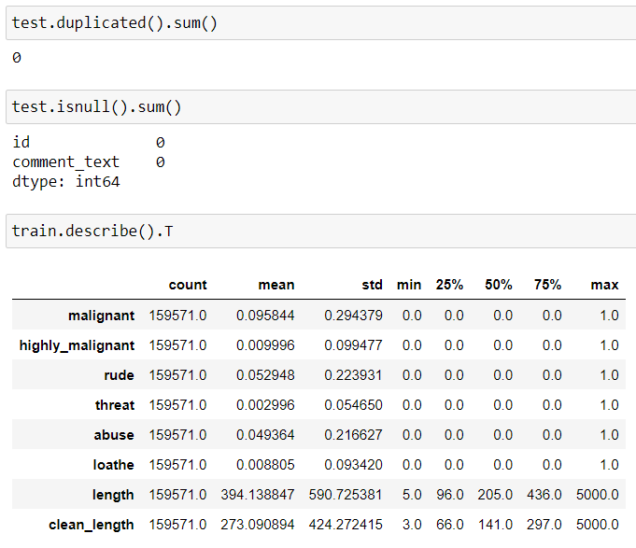

Slide 15
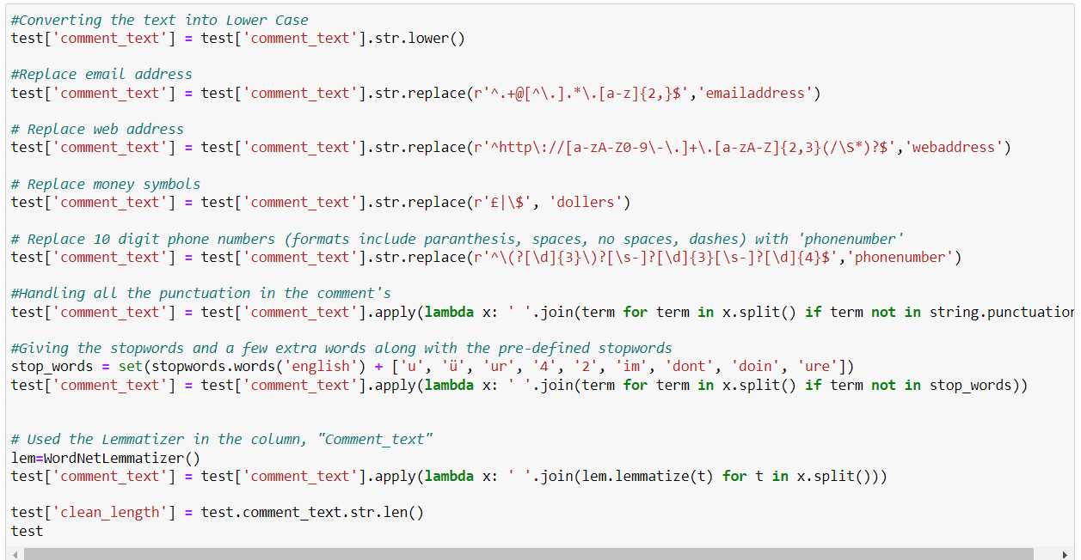
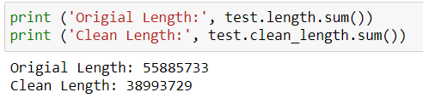

Slide 16
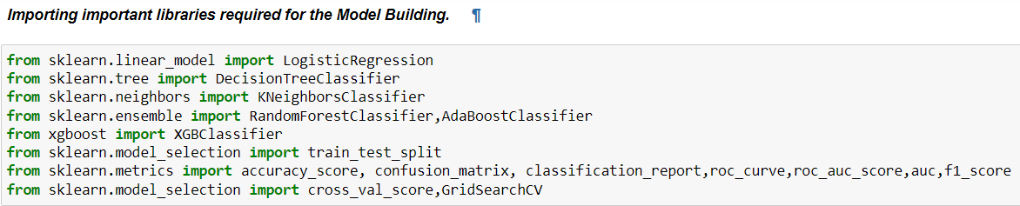
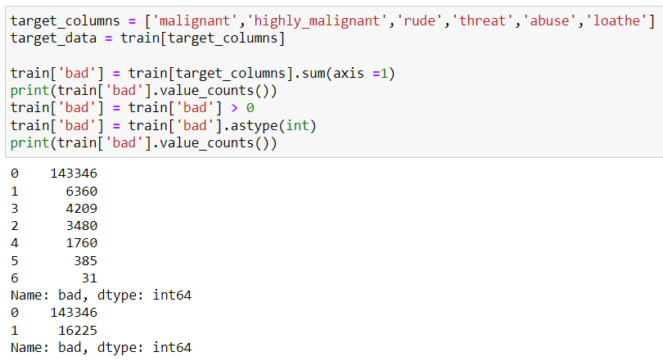
Model Building

Slide 17
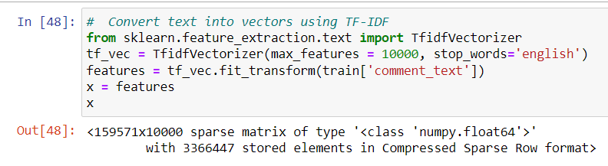
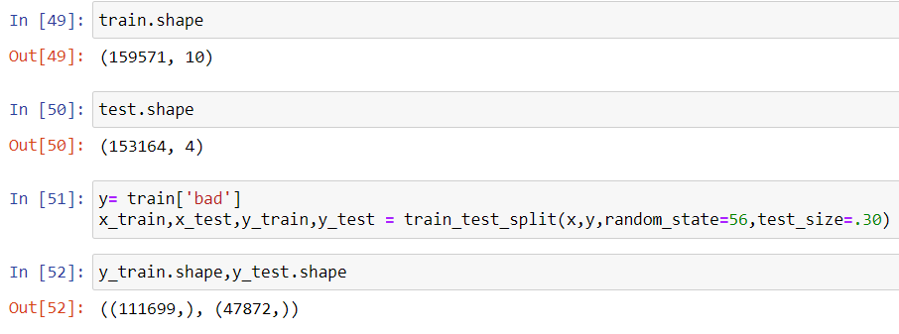

Slide 18
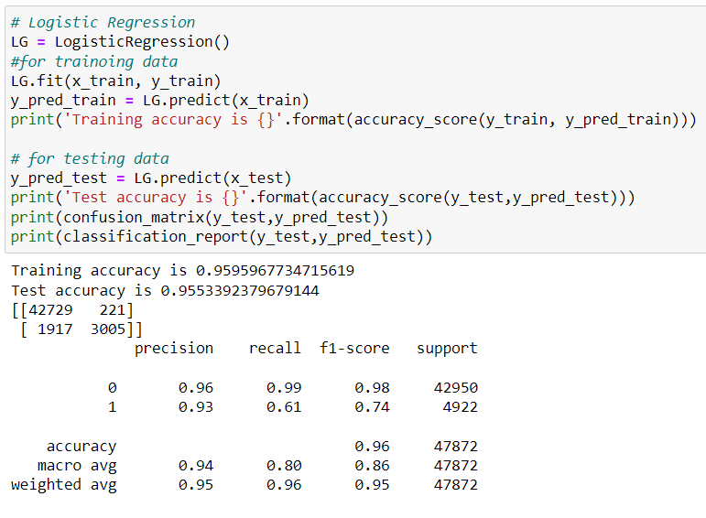
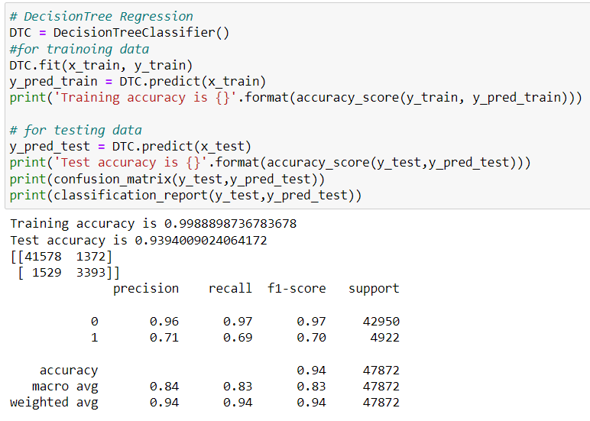

Slide 19
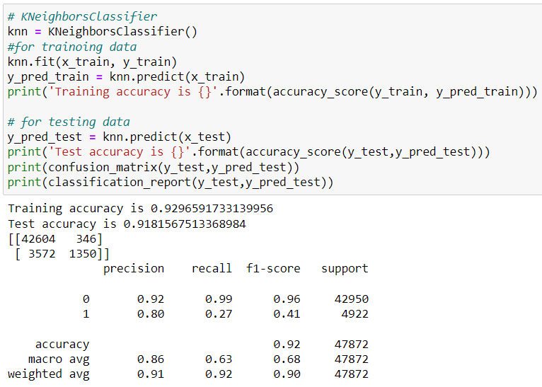
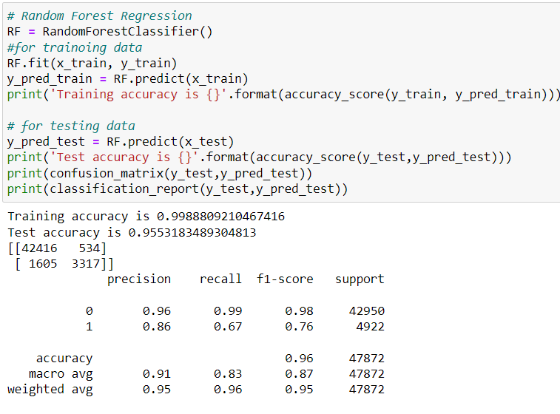

Slide 20
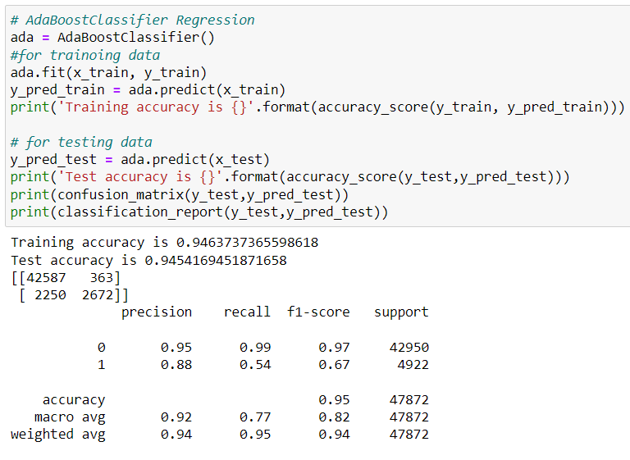
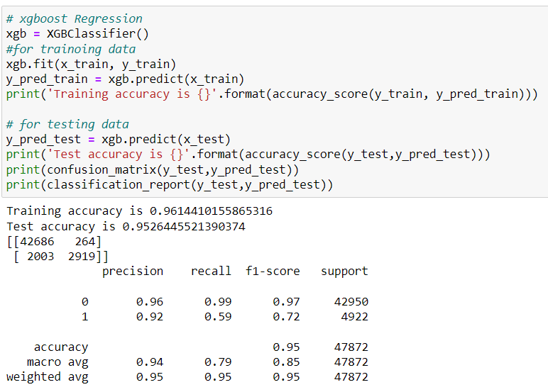

Slide 21
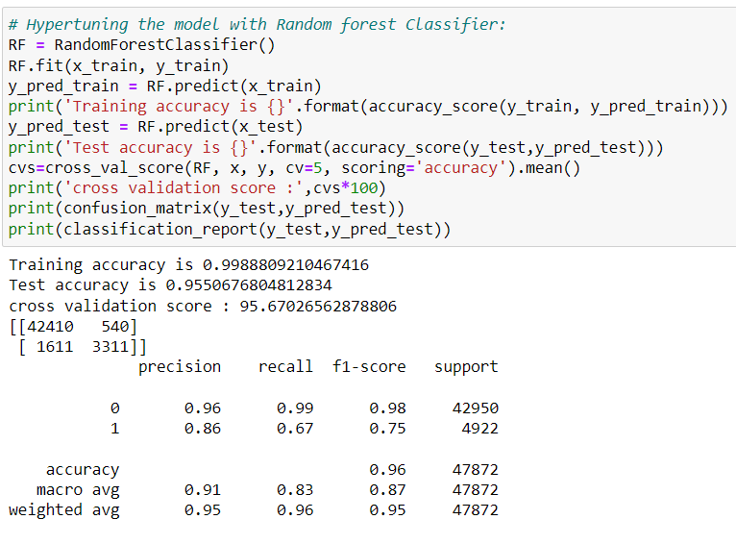
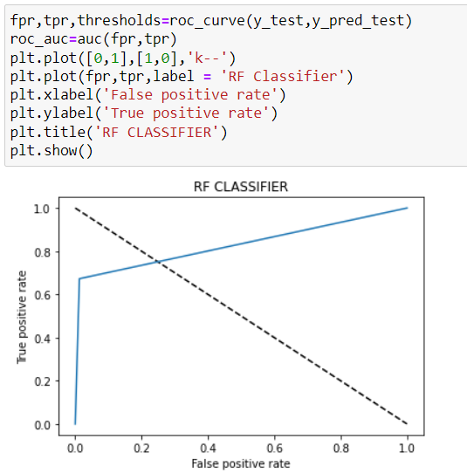

Slide 22
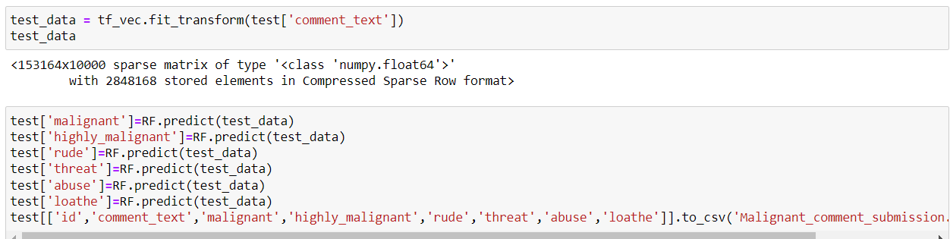
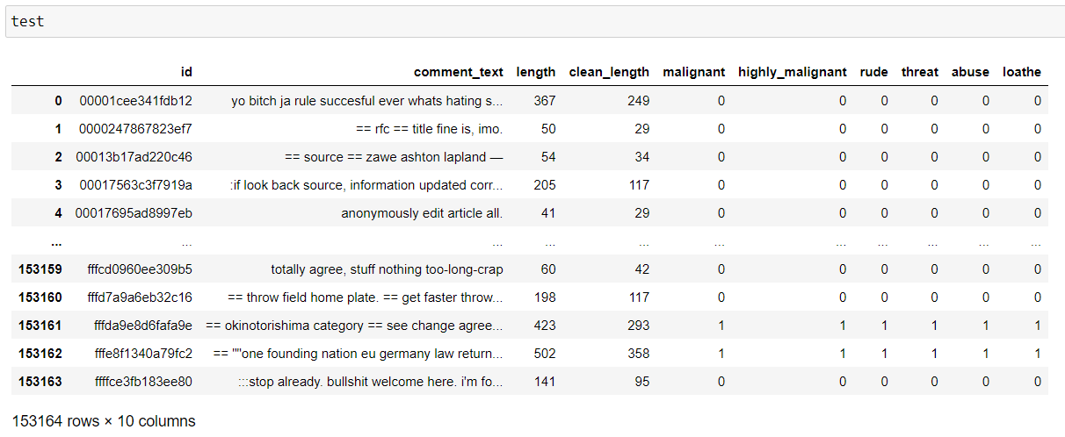

Slide 23
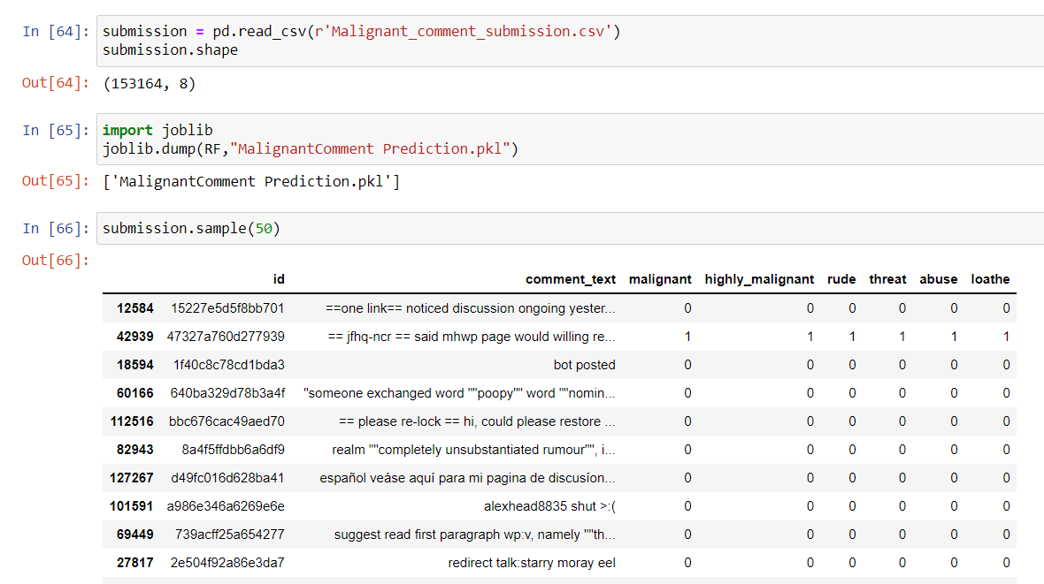

Slide 24
Key Findings & Conclusion of the Study
Online hate, described as abusive language, aggression, cyberbullying, hatefulness and many others has been identified as a major threat on online social media platforms. Social media platforms are the most prominent grounds for such toxic behaviour.
From the above analysis the below mentioned results were achieved which depicts the chances and conditions of a comment being a hateful comment or a normal comment.
It is possible to classify the comments content into the required categories of Malignant and Non Malignant. However, using this kind of project an awareness can be created to know what is good and bad. It will help to stop spreading hatred among people.

Slide 25

Thank You..!!!!

